Slide 1
Teaching Machines to Ask Questions
Kaichun Yao, Libo Zhang, Tiejian Luo, Lili Tao, YanJun Wu
IJCAI-18
Copyright © Shenglei Huang 2018.10.17

Slide 2
Contents
Task Definition
Naïve Deep Model
Weakness
Advanced Deep Model
Evaluation & Results
Conclusion
Copyright © Shenglei Huang 2018.10.17

Slide 3
Task Definition (1/6)
Paragraph
Question type
Key phrase
…It is a replica of the grotto at Lourdes, France where the Virgin Mary reputedly appeared to Saint Bernadette Soubirous in 1858. …
Who
Saint Bernadette Soubirous
Question Generator
Input: Paragraph + Key phrase + Type
Output: Question
To whom did the Virgin Mary allegedly appear in 1858 in Lourdes France?
Question
Copyright © Shenglei Huang 2018.10.17

Slide 4
Task Definition (1/6)
Paragraph
Question type
Key phrase
…It is a replica of the grotto at Lourdes, France where the Virgin Mary reputedly appeared to Saint Bernadette Soubirous in 1858. …
Who
Saint Bernadette Soubirous
Question Generator
Quiz 1: Which deep model can be used to do this task?
To whom did the Virgin Mary allegedly appear in 1858 in Lourdes France?
Question
Copyright © Shenglei Huang 2018.10.17

Slide 5
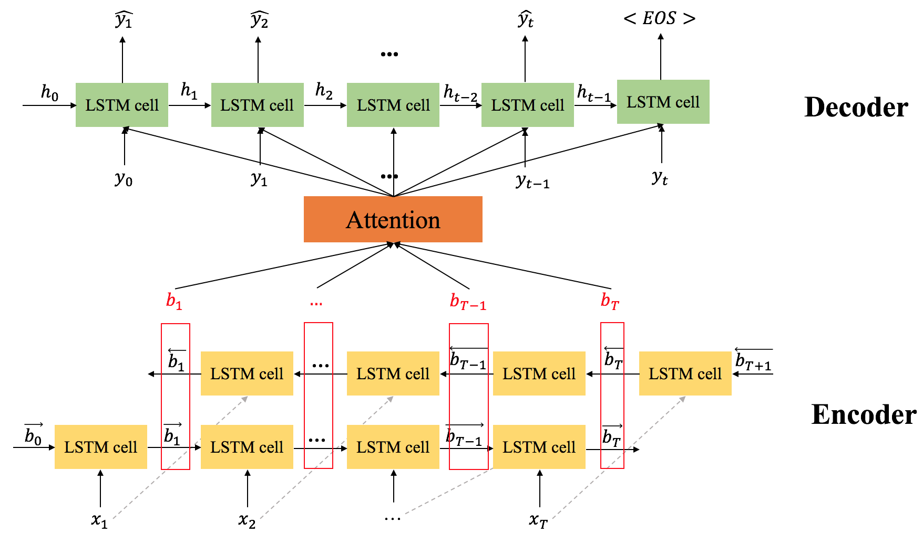
Naïve Deep Model (2/6)
Sequence to Sequence Model (Seq2Seq)
Du, X., Shao, J., & Cardie, C. (2017). Learning to Ask: Neural Question Generation for Reading Comprehension. In Proceedings of the 55th Annual Meeting of the Association for Computational Linguistics (Volume 1: Long Papers) (Vol. 1, pp. 1342-1352).
Copyright © Shenglei Huang 2018.10.17

Slide 6
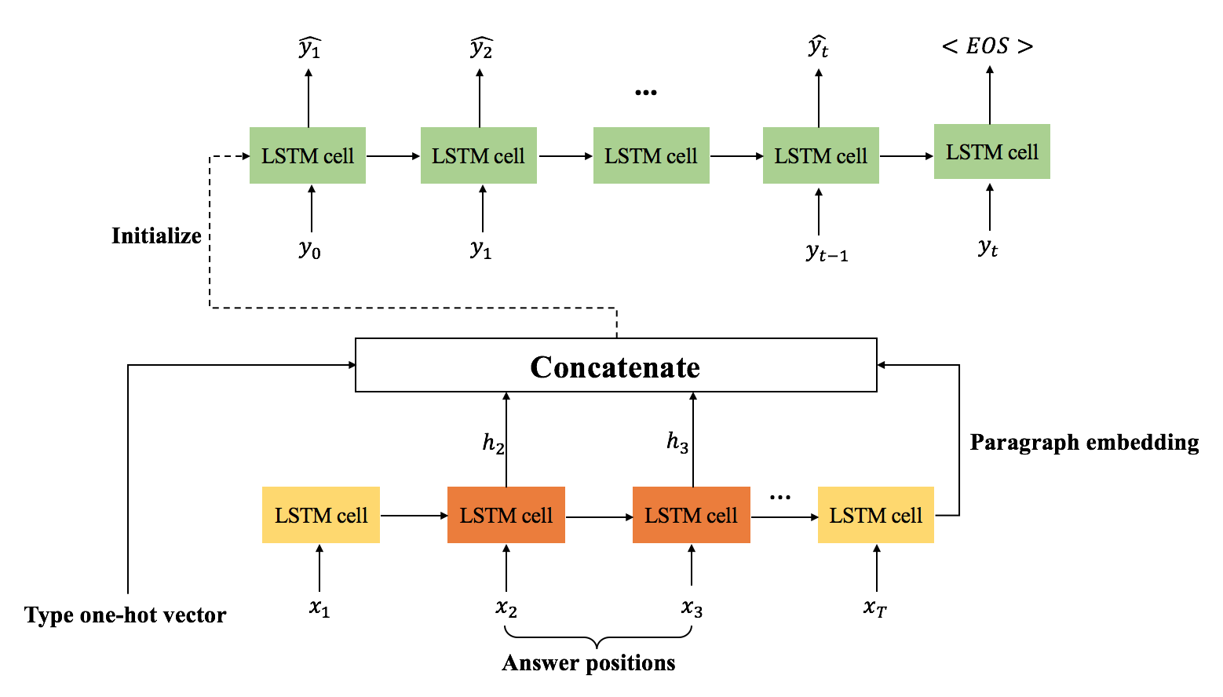
Naïve Deep Model (2/6)
Sequence to Sequence Model (Seq2Seq) with additional features
Copyright © Shenglei Huang 2018.10.17
Notes:
This is just one approach to add additional features to the model, which is used in this paper.

Slide 7
Naïve Deep Model (2/6)
Modified Sequence to Sequence Model (Seq2Seq)
Quiz 2: Through this model, how many questions could be generated with fixed paragraph and answer?
Copyright © Shenglei Huang 2018.10.17

Slide 8
Weakness (3/6)
Super Bowl 50 was an American football game to determine the champion of the National Football League (NFL) for the 2015 season. The American Football Conference (AFC) champion Denver Broncos defeated the National Football Conference (NFC) champion Carolina Panthers 24-10 to earn their third Super Bowl title… [Which]
Paragraph + answer + question type
Which NFL team represented the AFC at super bowl 50?
Which NFL team won super bowl 50?
Ground Truth Questions
Weakness: Naïve seq2seq model could generate only one question with fixed paragraph and answer and type, which limits the diversity of questions.
Copyright © Shenglei Huang 2018.10.17

Slide 9
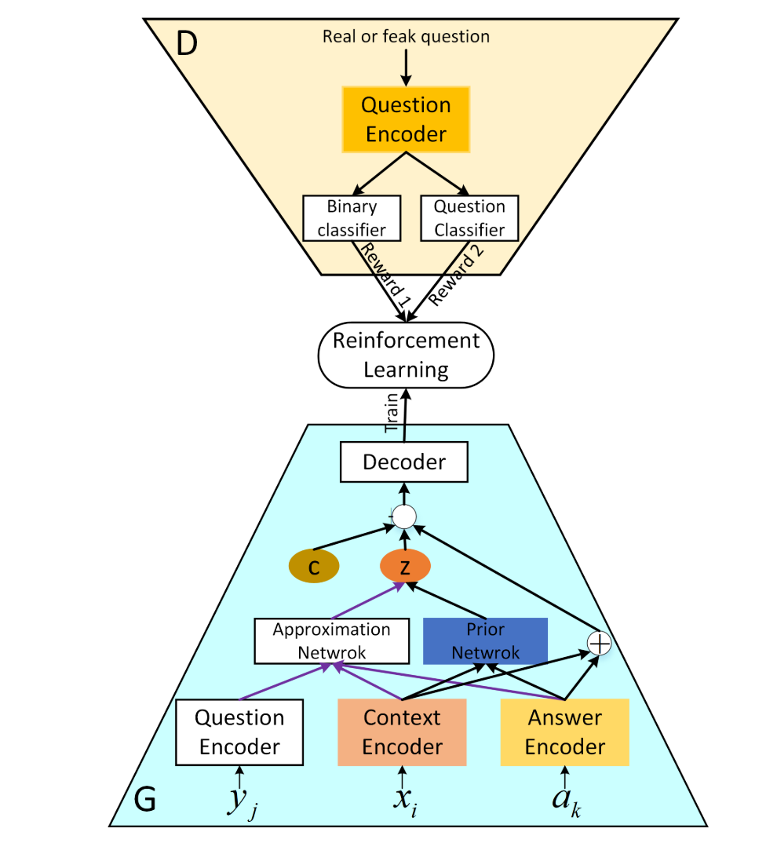
Advanced Deep Model (4/6)
Model Structure: Generative Adversarial Networks (GAN)
Learning Strategy: Reinforcement Learning (RL)
Copyright © Shenglei Huang 2018.10.17

Slide 10
Advanced Deep Model (4/6)
Discriminator: Two Classifiers
Generator: Variational Auto-Encoder (VAE)
Copyright © Shenglei Huang 2018.10.17

Slide 11
Advanced Deep Model (4/6)
The American Football Conference (AFC) champion Denver Broncos defeated the National Football Conference (NFC) champion Carolina Panthers 24-10 to earn their third Super Bowl title…
Which
Encoder 1
Embedding
0.2 | 0.31 | 0.2 | 0.21 | 0.34 | … | 0.21 | 0.45 | 0.01 | 0.67
Decoder 1
Which NFL team represented the AFC at super bowl 50?
Copyright © Shenglei Huang 2018.10.17

Slide 12


Advanced Deep Model (4/6)
The American Football Conference (AFC) champion Denver Broncos defeated the National Football Conference (NFC) champion Carolina Panthers 24-10 to earn their third Super Bowl title…
Which NFL team represented the AFC at super bowl 50?
Which
Encoder 2
Decoder 2
Distribution
0.1 | 0.43 | … | 0.22 | 0.53
0.5 | 0.13 | … | 0.26 | 0.67
Sampling
0.2 | 0.31 | 0.2 | 0.21 | 0.34 | … | 0.21 | 0.45 | 0.01 | 0.67
$$μ$$
$$σ$$
Paragraph embedding
Copyright © Shenglei Huang 2018.10.17

Slide 13
Advanced Deep Model (4/6)
The American Football Conference (AFC) champion Denver Broncos defeated the National Football Conference (NFC) champion Carolina Panthers 24-10 to earn their third Super Bowl title…
Which NFL team won super bowl 50?
Which
Encoder 2
Decoder 2
Distribution
0.1 | 0.43 | … | 0.22 | 0.53
0.5 | 0.13 | … | 0.26 | 0.67
Sampling
0.2 | 0.451 | 0.12 | 0.1 | 0.46 | … | 0.18 | 0.22 | 0.17 | 0.97
$$μ$$
$$σ$$
Paragraph embedding
Copyright © Shenglei Huang 2018.10.17

Slide 14
Advanced Deep Model (4/6)
The American Football Conference (AFC) champion Denver Broncos defeated the National Football Conference (NFC) champion Carolina Panthers 24-10 to earn their third Super Bowl title…
Which NFL team won super bowl 50?
Which
Encoder 2
Decoder 2
Distribution
0.1 | 0.43 | … | 0.22 | 0.53
0.5 | 0.13 | … | 0.26 | 0.67
Sampling
0.2 | 0.451 | 0.12 | 0.1 | 0.46 | … | 0.18 | 0.22 | 0.17 | 0.97
$$μ$$
$$σ$$
Paragraph embedding
VAE: Variational Auto-Encoder
Copyright © Shenglei Huang 2018.10.17

Slide 15


Advanced Deep Model (4/6)
The American Football Conference (AFC) champion Denver Broncos defeated the National Football Conference (NFC) champion Carolina Panthers 24-10 to earn their third Super Bowl title… + [Which]
Encoder 2
Encoder 1
Embedding
Distribution
0.1 | 0.43 | … | 0.22 | 0.53
0.5 | 0.13 | … | 0.26 | 0.67
$$μ$$
$$σ$$
Embedding
0.2 | 0.31 | 0.2 | 0.21 | 0.34 | … | 0.21 | 0.45 | 0.01 | 0.67
Sampling
0.2 | 0.451 | 0.12 | 0.1 | 0.46 | … | 0.18 | 0.22 | 0.17 | 0.97
Embedding
Decoder 1
Decoder
Which NFL team represented the AFC at super bowl 50?
Which NFL team won super bowl 50?
Copyright © Shenglei Huang 2018.10.17

Slide 16
Advanced Deep Model (4/6)
VAE Model Training
$$J_{gen}\left(θ,∅\right)=KL\left(Q_{∅}\left(z | X, A,T\right)||P_{θ}\left(z | X, A,T\right)\right)− E_{Q_{∅}\left(z | X, A,T\right)}[\log{P_{φ}(Y|z,X,A,T)}]$$
Distribution approximate loss
Question reconstruction loss
Copyright © Shenglei Huang 2018.10.17
Notes:
P: prior distribution (X,A,T)
Q: approximate distribution (Q,X,A,T)

Slide 17
Advanced Deep Model (4/6)
Discriminator
Binary Classifier: Real question or Fake question
Type Classifier: Correct question type or not
Copyright © Shenglei Huang 2018.10.17

Slide 18
Advanced Deep Model (4/6)
Discriminator
Binary Classifier: Real question or Fake question
Type Classifier: Correct question type or not
Quiz 3: Could this model be trained end-to-end with one loss function just like pure seq2seq model?
Copyright © Shenglei Huang 2018.10.17

Slide 19
Advanced Deep Model (4/6)
Discriminator
Binary Classifier: Real question or Fake question
Type Classifier: Correct question type or not
Quiz 3: Could this model be trained end-to-end with one loss function just like pure seq2seq model?
No!!!
Copyright © Shenglei Huang 2018.10.17

Slide 20
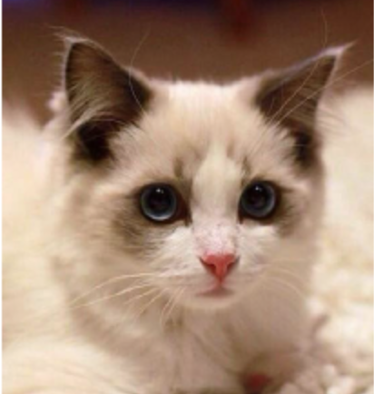

Advanced Deep Model (4/6)
cat
?
0.25
0.05
0.22
0.12
0.2
0.87
0.25
0.46
0.2
0.11
0.22
0.12
0.2
0.07
0.25
0.46
0.2
0.11
CV: each digit could represent one pixel
NLP: not all vector could represent a word
Copyright © Shenglei Huang 2018.10.17
Notes:
discriminator的inputs是word embedding，所以是不能导到generator处了

Slide 21
Advanced Deep Model (4/6)
Reinforcement Learning
Reward = Dis_Loss
Generator
Discriminator
Policy Gradient: Multiple this reward to generator loss
Copyright © Shenglei Huang 2018.10.17

Slide 22
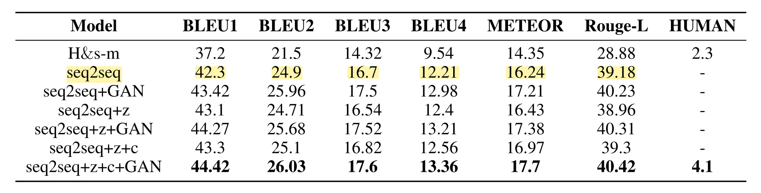
Evaluation & Results (5/6)
Results
(1)
(2)
(3)
(4)
(5)
(6)
GAN improves the model performance
VAE improves the model performance (Average score after three samples)
Type feature improves the model performance (Best scores in all types)
Copyright © Shenglei Huang 2018.10.17

Slide 23
Conclusion (6/6)
Knowledge Take-Away
VAE improves the diversity of generated questions by sampling from the trained distribution.
GAN is an idea rather than a specific model, which uses adversarial training to improve the performance of the model.
When applying GAN in seq2seq model, RL is used to solve the problem of blocked gradient.
Copyright © Shenglei Huang 2018.10.17

Slide 24
Thank you ☺
Copyright © Shenglei Huang 2018.10.17

Slide 25














$$\hat{y_{1}}$$
$$\hat{y_{2}}$$
$$\hat{y_{t}}$$
$$<EOS>$$
...
LSTM cell
LSTM cell
LSTM cell
LSTM cell
LSTM cell
Initialize
$$y_{0}$$
$$y_{1}$$
$$y_{t−1}$$
$$y_{t}$$
Concatenate
$$h_{2}$$
$$h_{3}$$
Paragraph embedding
LSTM cell
LSTM cell
LSTM cell
…
LSTM cell
Type one-hot vector
$$x_{1}$$
$$x_{2}$$
$$x_{3}$$
$$x_{T}$$
Answer positions

Slide 26





















$$\hat{y_{1}}$$
$$\hat{y_{2}}$$
$$\hat{y_{t}}$$
$$<EOS>$$
...
$$h_{0}$$
LSTM cell
$$h_{1}$$
LSTM cell
$$h_{2}$$
LSTM cell
$$h_{t−2}$$
LSTM cell
$$h_{t−1}$$
LSTM cell
Decoder
...
$$y_{0}$$
$$y_{1}$$
$$y_{t−1}$$
$$y_{t}$$
Attention
$$b_{1}$$
$$…$$
$$b_{T−1}$$
$$b_{T}$$
$$\overset{⃖}{b_{1}}$$
LSTM cell
…
LSTM cell
$$\overset{⃖}{b_{T−1}}$$
LSTM cell
$$\overset{⃖}{b_{T}}$$
LSTM cell
$$\overset{⃖}{b_{T+1}}$$
Encoder
$$\vec{b_{0}}$$
LSTM cell
$$\vec{b_{1}}$$
LSTM cell
…
LSTM cell
$$\vec{b_{T−1}}$$
LSTM cell
$$\vec{b_{T}}$$
$$x_{1}$$
$$x_{2}$$
…
$$x_{T}$$

